Slide 1

School of Computing Scienceand Engineering
TOPIC: GENETIC ALGORITHM USING PYTHON
TEAM MEMBERS
Md Nadeem Sarwar: 20SCSE1010767
Ziyauddin Zamir: 20SCSE1010729
Abhishek Kumar: 20SCSE1010368
Project ID: BT3130

Slide 2
School of Computing Scienceand Engineering
After scientists became disillusioned with classical and neo-classical attempts at modeling intelligence, they looked in other directions.
Two prominent fields arose, connectionism (neural networking, parallel processing) and evolutionary computing.
It is the latter that this essay deals with - genetic algorithms and genetic programming
A genetic algorithm (or GA) is a search technique used in computing to find true or approximate solutions to optimization and search problems.
Genetic algorithms are categorized as global search heuristics.
Genetic algorithms are a particular class of evolutionary algorithms that use techniques inspired by evolutionary biology such as inheritance, mutation, selection, and crossover (also called recombination).

Slide 3
School of Computing Scienceand Engineering
Key Terms
Individual - Any possible solution
Population - Group of all individuals
Search Space - All possible solutions to the problem
Chromosome - Blueprint for an individual
Trait - Possible aspect (features) of an individual
Allele - Possible settings of trait (black, blond, etc.)
Locus - The position of a gene on the chromosome
Genome - Collection of all chromosomes for an individual

Slide 4
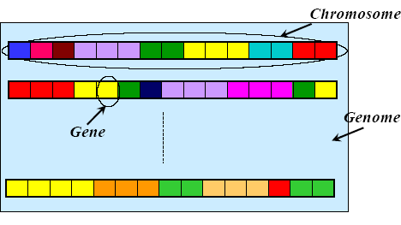
School of Computing Scienceand Engineering
Chromosome, Genes and Genomes

Slide 5
School of Computing Scienceand Engineering
Genotype and Phenotype
Genotype:
– Particular set of genes in a genome
Phenotype:
– Physical characteristic of the genotype (smart, beautiful, healthy, etc.)

Slide 6
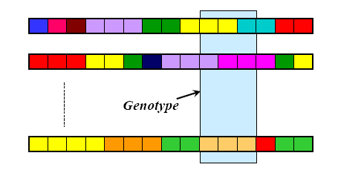
School of Computing Scienceand Engineering
Genotype and Phenotype

Slide 7
School of Computing Scienceand Engineering
GA Requirements
A typical genetic algorithm requires two things to be defined:
a genetic representation of the solution domain, and
a fitness function to evaluate the solution domain.
A standard representation of the solution is as an array of bits. Arrays of other types and structures can be used in essentially the same way.
The main property that makes these genetic representations convenient is that their parts are easily aligned due to their fixed size, that facilitates simple crossover operation.
Variable length representations may also be used, but crossover implementation is more complex in this case.
Tree-like representations are explored in Genetic programming.

Slide 8
School of Computing Scienceand Engineering
Representation
Chromosomes could be:
Bit strings (0101 ... 1100)
Real numbers (43.2 -33.1 ... 0.0 89.2)
Permutations of element (E11 E3 E7 ... E1 E15)
Lists of rules (R1 R2 R3 ... R22 R23)
Program elements (genetic programming)
... any data structure ...

Slide 9
School of Computing Scienceand Engineering
GA Requirements
The fitness function is defined over the genetic representation and measures the quality of the represented solution.
The fitness function is always problem dependent.
For instance, in the knapsack problem, we want to maximize the total value of objects that we can put in a knapsack of some fixed capacity.
A representation of a solution might be an array of bits, where each bit represents a different object, and the value of the bit (0 or 1) represents whether or not the object is in the knapsack.
Not every such representation is valid, as the size of objects may exceed the capacity of the knapsack.
The fitness of the solution is the sum of values of all objects in the knapsack if the representation is valid, or 0 otherwise. In some problems, it is hard or even impossible to define the fitness expression; in these cases, interactive genetic algorithms are used.

Slide 10
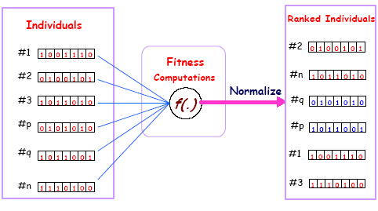
School of Computing Scienceand Engineering
A fitness function

Slide 11
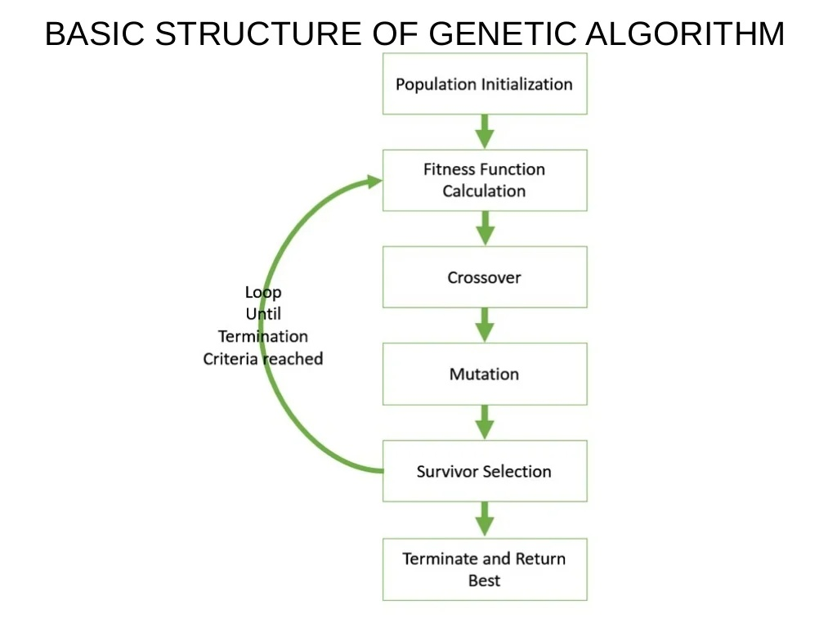
School of Computing Scienceand Engineering

Slide 12
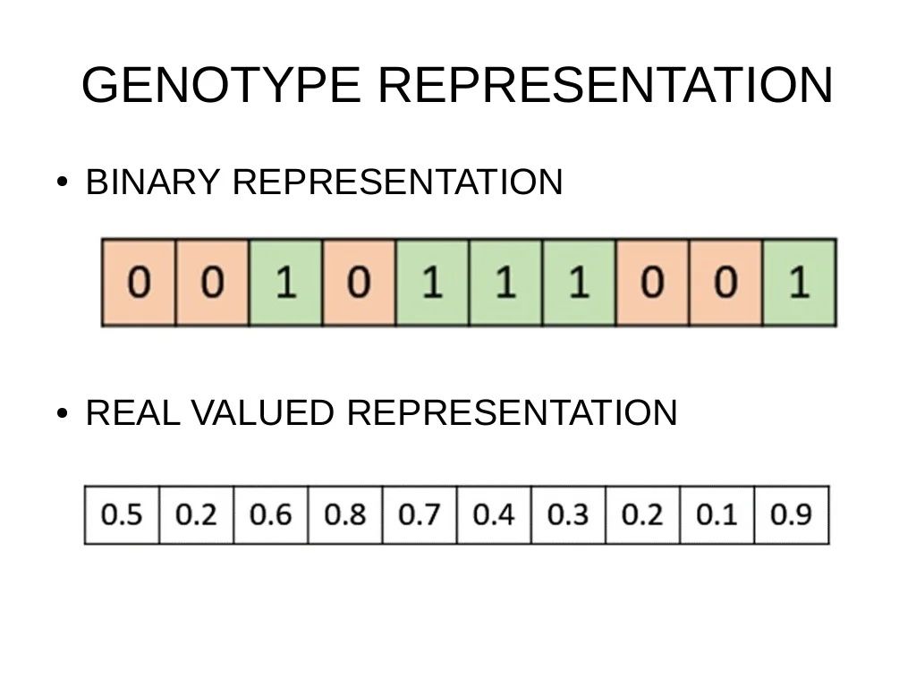
School of Computing Scienceand Engineering

Slide 13
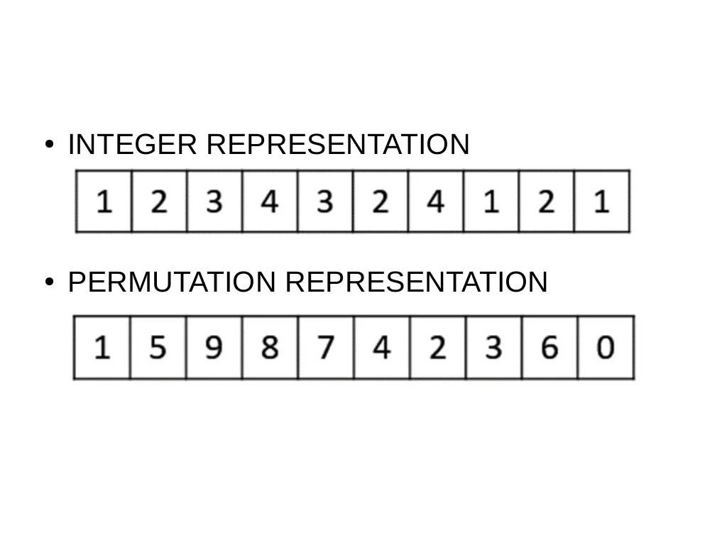
School of Computing Scienceand Engineering
GA-POPULATION
Population is a subset of solution in the current generation
Set of chromosomes

Slide 14
School of Computing Scienceand Engineering
POPULATION INITIALIZATION
1. RANDOM INITIALIZATION
2. HEURISTIC INITIALIZATION
POPULATION MODEL
STEADY STATE
GENERATIONAL

Slide 15
School of Computing Scienceand Engineering
FITNESS FUNCTION
Takes a candidate solution to the problem asinput and produces as output
The objective is to either maximize or minimizethe given objective function

Slide 16
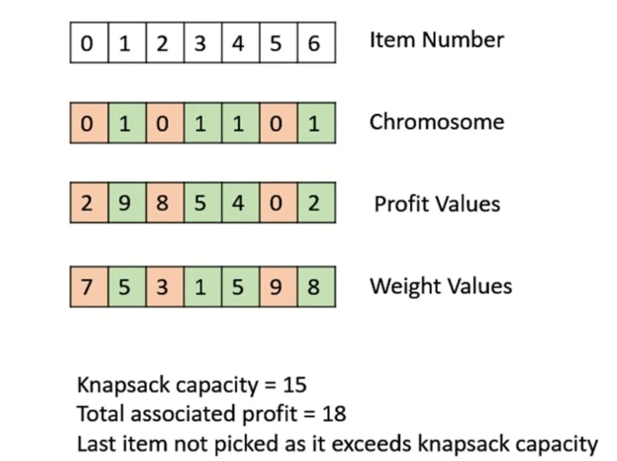
School of Computing Scienceand Engineering

Slide 17
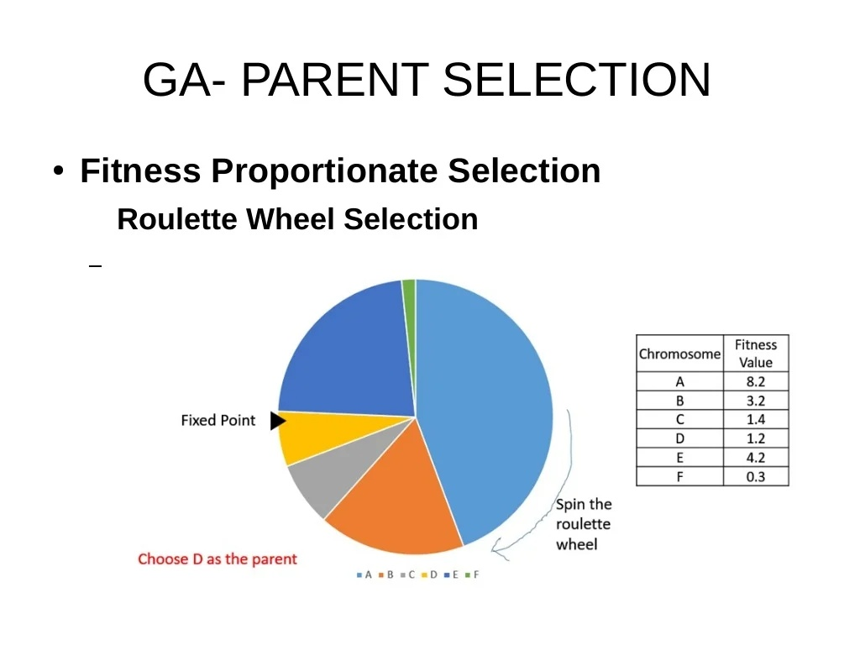
School of Computing Scienceand Engineering

Slide 18
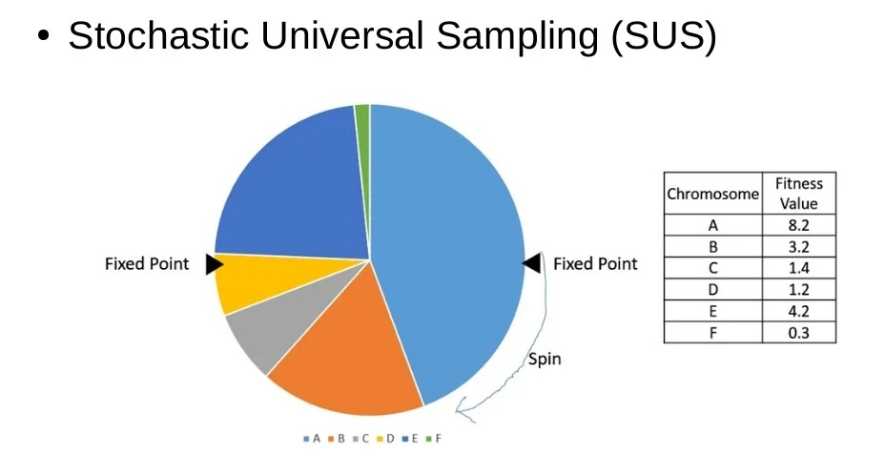
School of Computing Scienceand Engineering

Slide 19
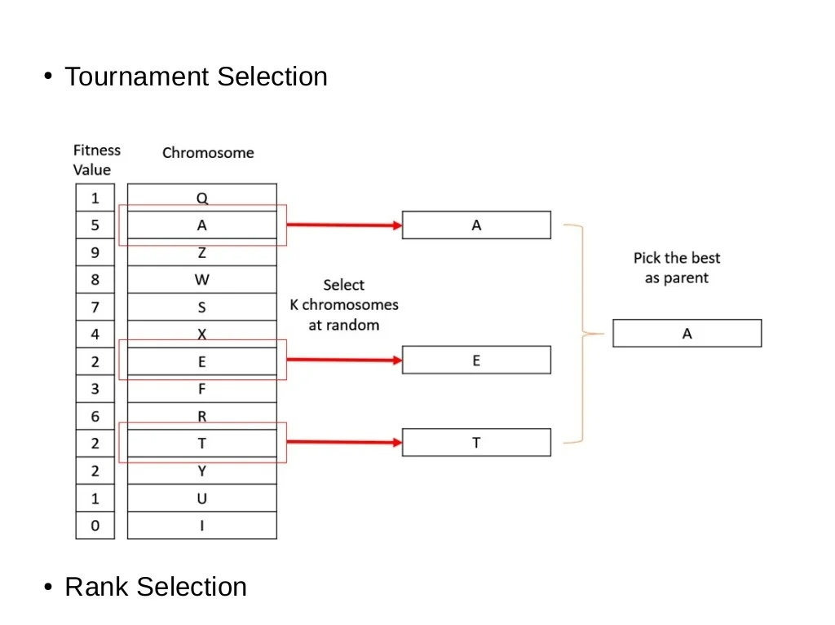
School of Computing Scienceand Engineering

Slide 20
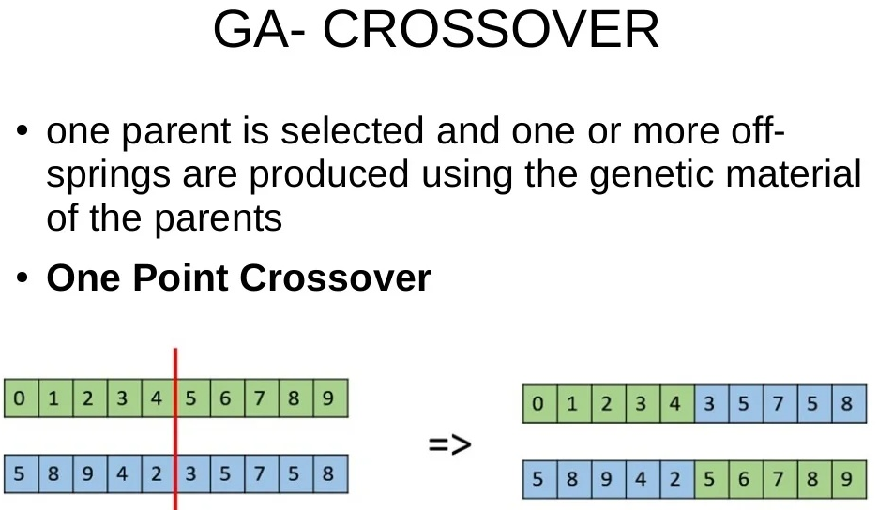
School of Computing Scienceand Engineering

Slide 21
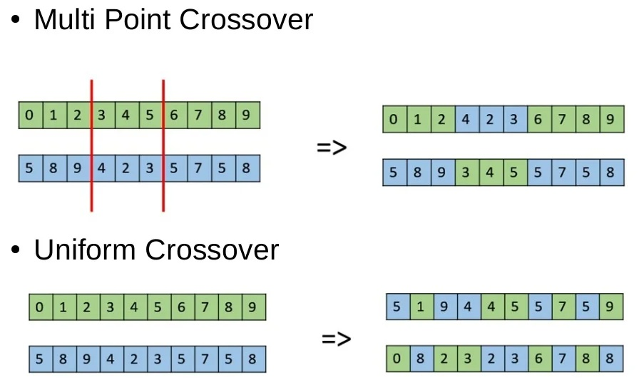
School of Computing Scienceand Engineering

Slide 22
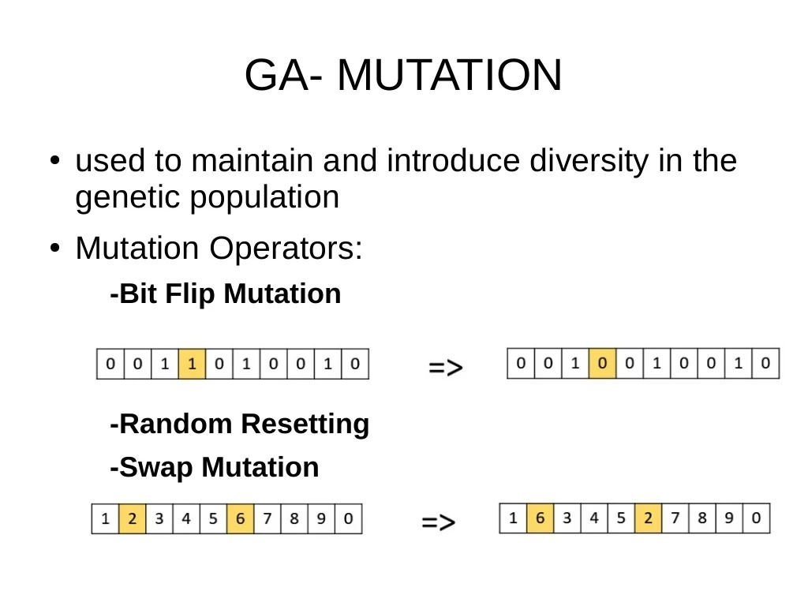
School of Computing Scienceand Engineering

Slide 23
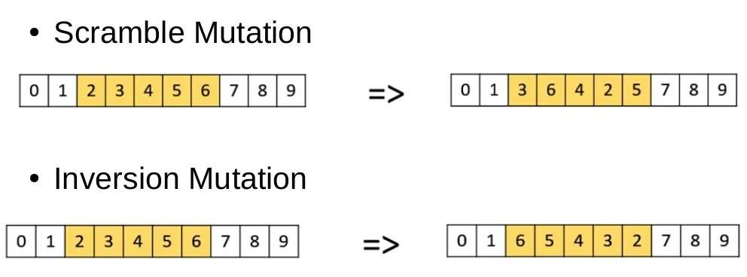
School of Computing Scienceand Engineering

Slide 24
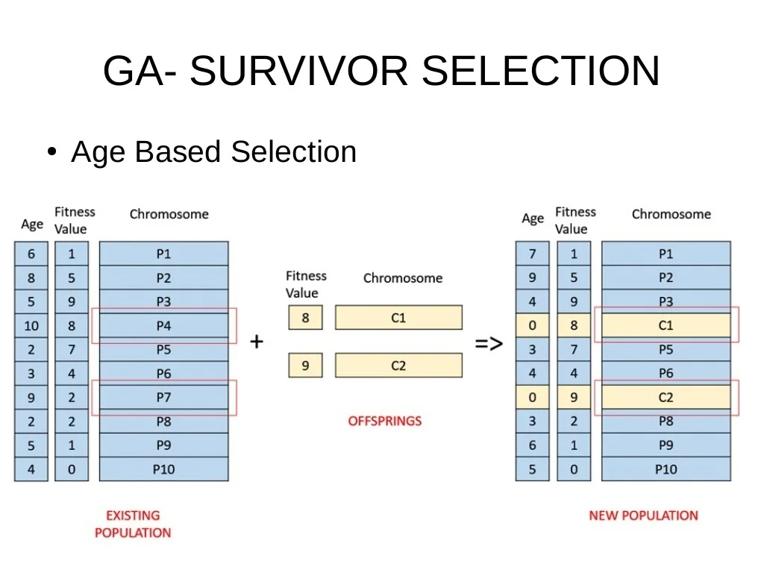
School of Computing Scienceand Engineering

Slide 25
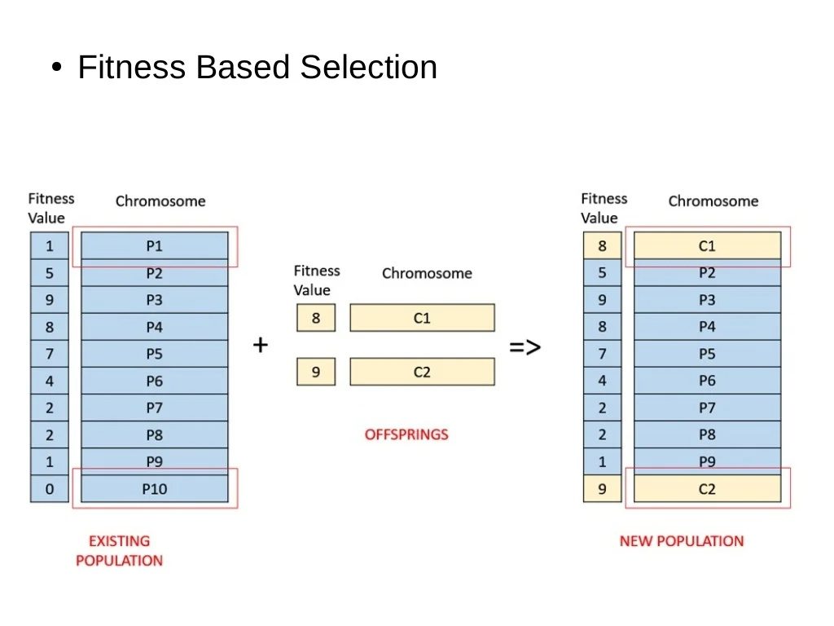
School of Computing Scienceand Engineering

Slide 26
School of Computing Scienceand Engineering
Step 1. Perform Exploratory Data Analysis (EDA)
There are a total of 284,807 transactions with only 492 of them being fraud. Let’s import the necessary modules,
load our dataset, and perform EDA on our dataset . Then, check for null values in the credit card dataset. Now,
let’s check the number of occurrences of each class label and plot the information using matplotlib. Now, it’s time
to split credit card data with a split of 70-30 using train_test_split().
Step 2: Apply Machine Learning Algorithms to Credit Card Dataset
We can apply a variety of algorithms for this problem like Random Forest, Decision Tree, Support Vector Machine algorithms, etc.
In this machine learning project, we build Random Forest and Decision Tree classifiers and see which one works
best. We address the “class imbalance” problem by picking the best-performed model.

Slide 27
Continue…….
GA- TERMINATION CONDITION
When there has been no improvement in thepopulation for X iterations.
When we reach an absolute number ofgenerations.
When the objective function value has reacheda certain pre-defined value

Slide 28


